Slide 1
TWITTER ANALYSIS FOR CRYPTOCURRENCY INVESTMENT
DS501 - Group 1
September 21, 2017

Slide 2
Hello!
We are Team 1.
Claire Danaher Jonathan Friedman Janvi Kothari
Renee Sweeney Erin Teeple

Slide 3
Case Study #1
OVERALL GOAL: Learn to extract and use twitter data for the purposes solving a business problem
OUR APPROACH: Use twitter data to analyze user sentiment related to cryptocurrencies for the purposes of better understanding the market

Slide 4
DEFINITION: CRYPTOCURRENCY
“A cryptocurrency is a digital asset designed to work as a medium of exchange using cryptography to secure the transactions and to control the creation of additional units of the currency. Cryptocurrencies are classified as a subset of digital currencies and are also classified as a subset of alternative currencies and virtual currencies.”
Source: Wikipedia

Slide 5
WHY IS IT INTERESTING?
Lack of regulation- transfers are not monitored by a central authority
Profit-values fluctuate relative to other currency forms creating a market for trade

Slide 6

WHERE THERE IS PROFIT THERE IS BUSINESS
CAN TWITTER SENTIMENT BE USED TO TRACK THE CRYPTOCURRENCY MARKET?

Slide 7
DATA COLLECTION
TIME METHODS
Duration of 5 days
Weekdays and Weekends
Mornings, Midday and Evenings
SEARCH TERMS
Bitcoin
XRP
Etherium
Litecoin
Namecoin

Slide 8
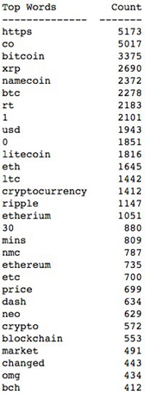
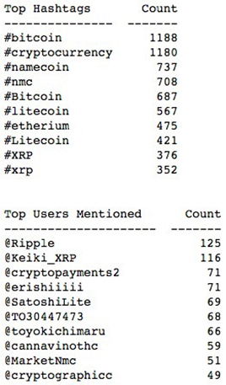
Top Words & Hashtags

Slide 9
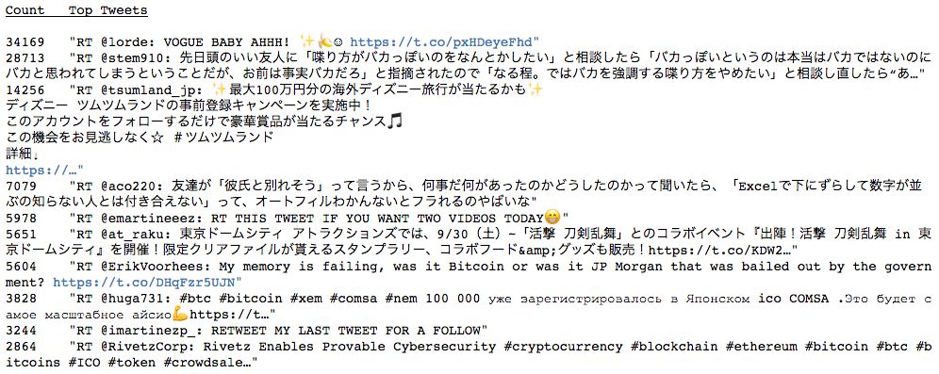
TOP TWEETS

Slide 10
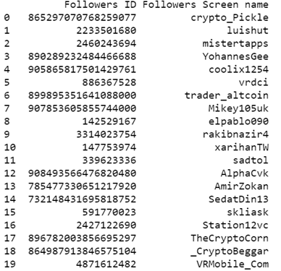
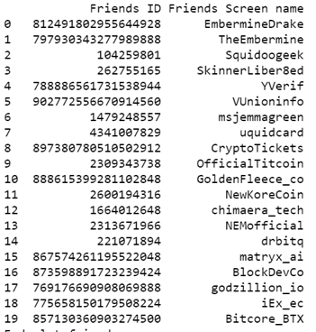
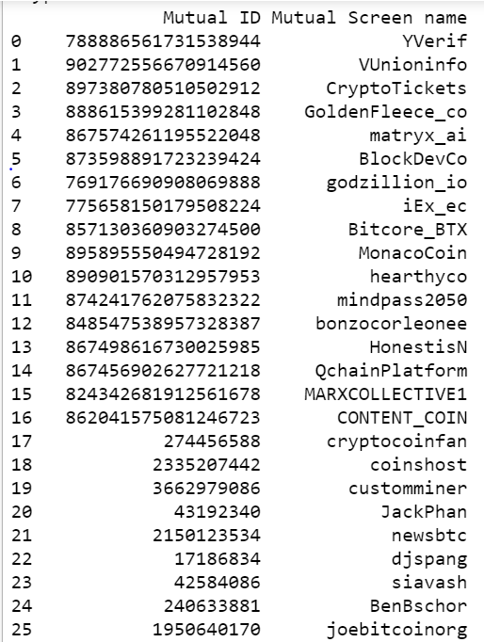
Popular User: @cryptocointalk
Followers count : 29,344
Friends count :
998
Mutual friends & followers count :
995

Slide 11
SENTIMENT ANALYSIS & TEXTBLOB
TEXTBLOB- natural language processing program which scores text strings on polarity and subjectivity
  Polarity-range from highly negative [-1] to highly positive [1]
  Subjectivity-range from very objective [0] to highly subjective [1]
ANALYSIS- analyze the relationship between the the polarity scores calculated used textblob to the %change in the market

Slide 12
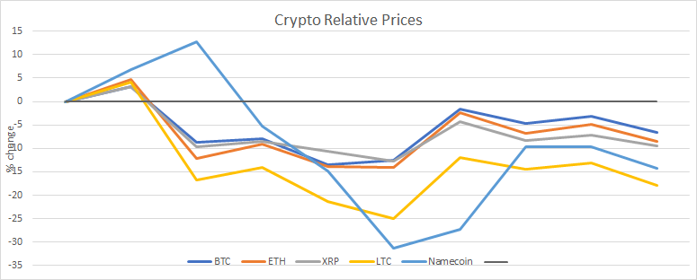
Cryptocurrency Relative Price During Analysis

Slide 13
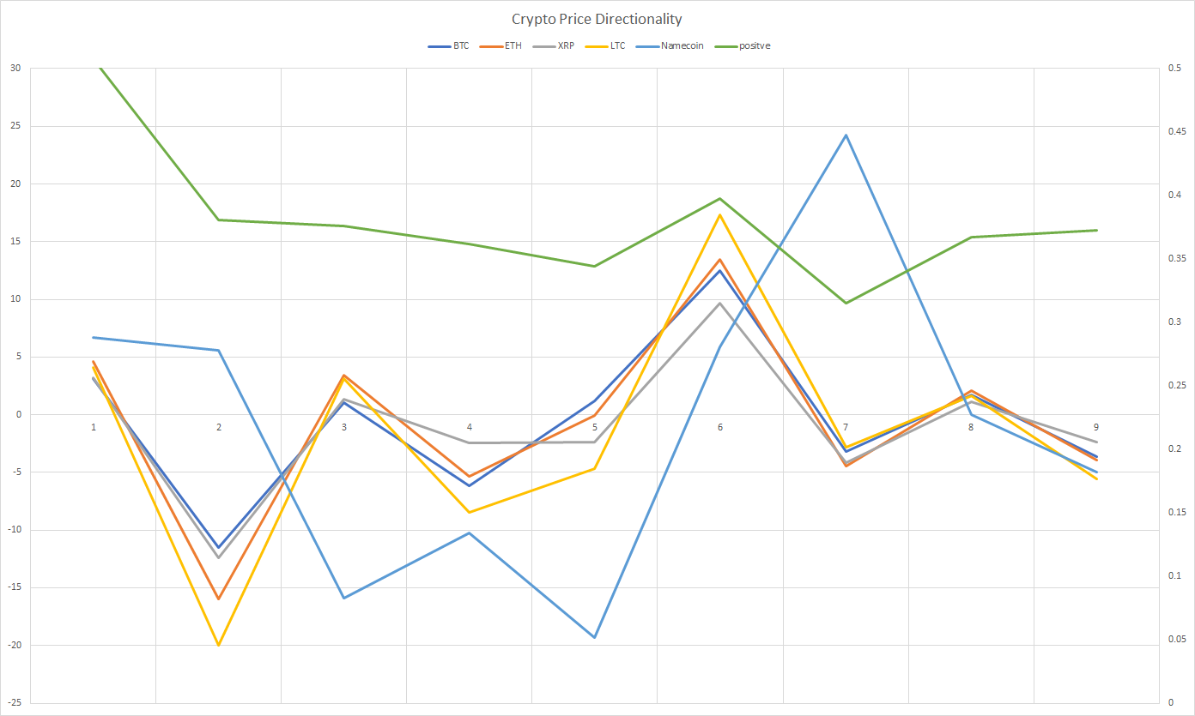
Cryptocurrency Price Directionality Against Overall Positive Sentiment

Slide 14
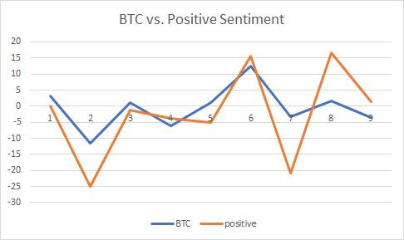
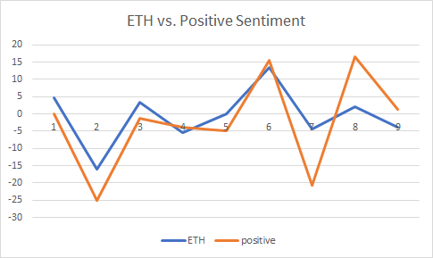
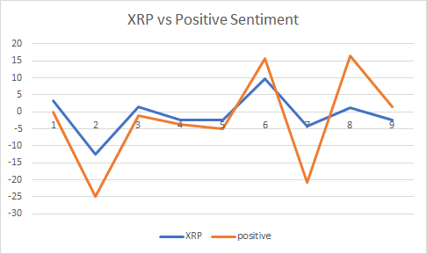
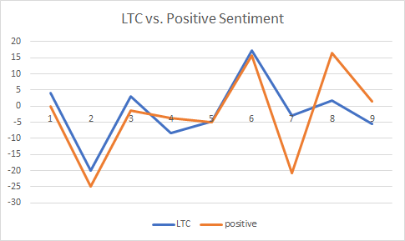
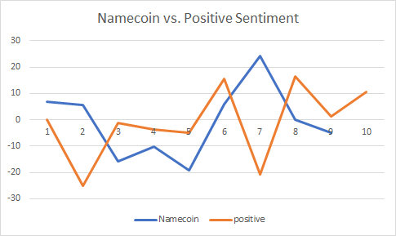
Individual Cryptocurrency Price Directionality Against Overall Positive Sentiment

Slide 15
“Two of the country's most prominent bitcoin exchanges, BTC China and Via BTC, said they will halt trading this month. BTC China has also stopped registering new users, it said in a statement posted on social media.”- CNN TECH
SOURCE:
CNN TECH
09/15/17
SOURCE:
CNBC
09/14/17
“On Tuesday, [JPMorgan CEO Jamie] Dimon called bitcoin a ‘fraud’, described it as ‘not a real thing’ and said, ‘someone is going to get killed.’ Crypto enthusiasts took little time in firing back -- on Twitter...”
QUESTION: DID WE GET LUCKY?

Slide 16
ANSWER: MAYBE
Twitter data provided an intriguing window into understanding the cryptocurrency market
Positive cryptocurrency tweet sentiment was observed to track with cryptocurrency price trends
Limitations-extremely small duration and low frequency of data collection makes generalization difficult

Slide 17
Thanks!
Any questions?

Slide 18
Credits
Special thanks to all the people who made and released these awesome resources for free:
Presentation template by SlidesCarnival
Photographs by Unsplash

